Slide 1

Can We Predict Heart Disease?
Jacob Darmofal
Vincent Elequin
Tamica Grant
Isidore Lozano
Notes:
Isidore

Slide 2

Objective
Using CDC survey data from 2000 to 2020 of 400,000 adults.
We intend to collect and analyze the data to build machine learning models to understand which characteristics (gender, age, race/ethnicity, etc.) to predict heart disease risk factors.
Using Pandas, Matplotlib, and PostgreSQL to visualize mortality predictions.
Determine if there are high risk populations geographically
Notes:
Isidore

Slide 3

Resources
Personal Key Indicators of Heart Disease | Kaggle
Heart Disease Stroke Prevention Vital Statistics from CDC (https://chronicdata.cdc.gov/Heart-Disease-Stroke-Prevention/National-Vital-Statistics-System-NVSS-National-Car/kztq-p2jf)
The above databases are made available under the Open Database License: http://opendatacommons.org/licenses/odbl/1.0/. Any rights in individual contents of the database are licensed under the Database Contents License: http://opendatacommons.org/licenses/dbcl/1.0/
Microsoft Bing for pics https://www.bing.com/images/create
ChatGPT (www.openai.com)
Neural Networks https://scikit-learn.org/
Imbalanced Learn https://imbalanced-learn.org/stable/references/generated/imblearn.over_sampling.SMOTE.html
Tableau https://www.tableau.com
Notes:
Isidore

Slide 4

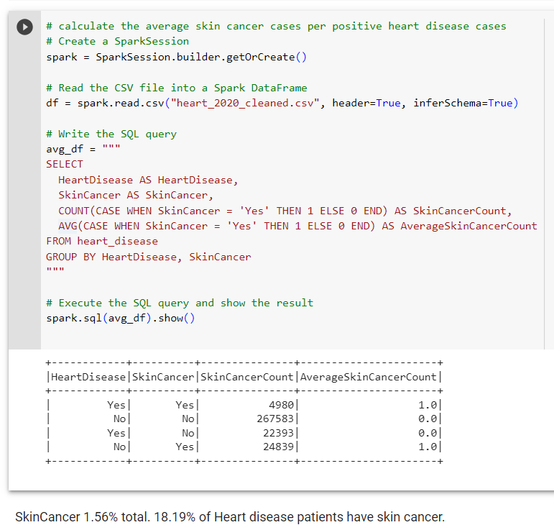
Evaluating Contributors with Spark
Contributors as they effect Total patients polled
Smoking – 5.01%
Drinking – 0.357%
Stroke – 1.37%
Difficulty Walking – 3.14%
Asthma – 1.54%
Kidney Disease 1.08%
Diabetic – 2.85%
Skin Cancer – 1.56%
Contributors per total patients with Heart Disease
Smoking – 58.59%
Drinking – 4.18%
Stroke – 16.03%
Difficulty Walking – 36.63%
Asthma – 18.02%
Kidney Disease - 12.62%
Diabetic – 33.12%
Skin Cancer – 18.19%
Only 8.56% of the test population was positive for Heart Disease
Notes:
Vince

Slide 5

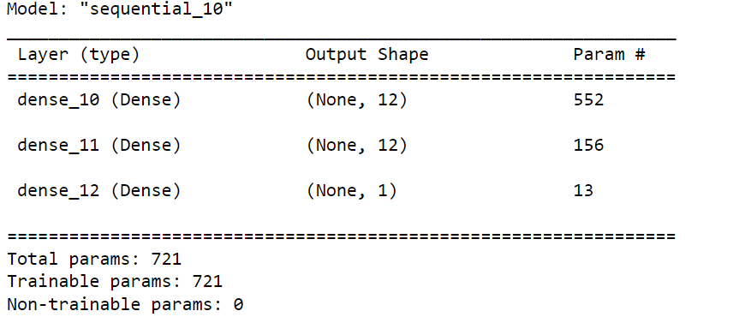
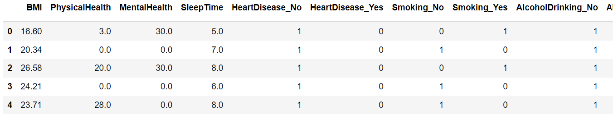
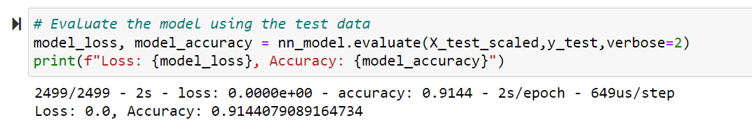
Neural Network Model Accuracy
Notes:
Vince

Slide 6
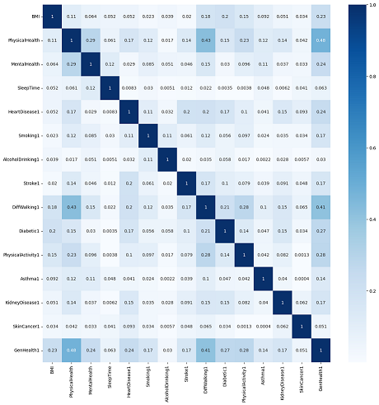
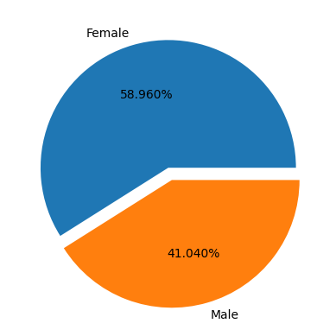
Key findings
Notes:
Jacob
Total survey contributors
Smoking – 58.59%
Drinking – 4.18%
Stroke – 16.03%
Difficulty Walking – 36.63%
Asthma – 18.02%
Kidney Disease - 12.62%
Diabetic – 33.12%
Skin Cancer – 18.19%

Slide 7
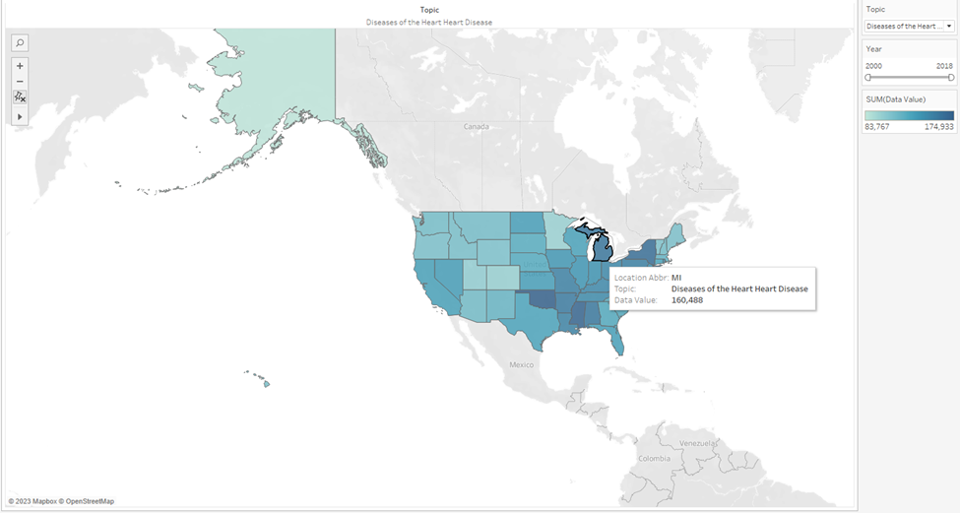
Key findings
Notes:
Tamica
Diseases of the heart map
Heart Disease Map | Tableau Public

Slide 8
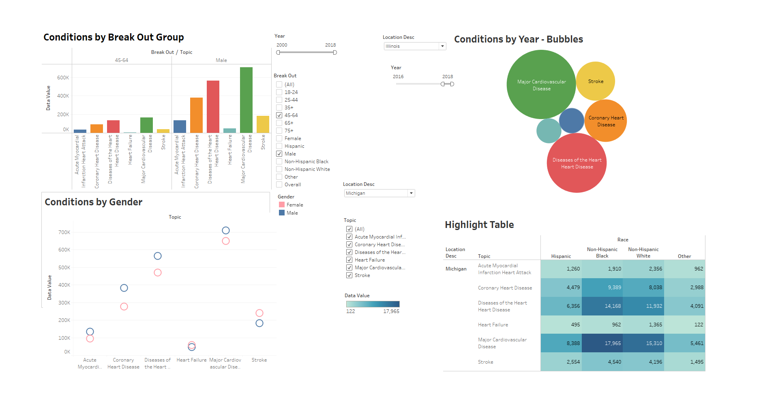
Key findings
Notes:
Tamica
Tableau Dashboard
Heart Disease Dashboard | Tableau Public

Slide 9

47.46% of of patients that were identified as having Heart Disease are white men over 50 (12,991Ttl)
,
Notes:
Isidore

Slide 10

Limitations
The data showed that there is an imbalance in the number of heart disease records, indicating an uneven distribution of data between people with and without heart disease (only 8.56% of the test population was positive for Heart Disease).
This can greatly bias the trained model's prediction of heart disease.
The datasets only provided US data
Data only looked at heart disease as a whole
Different kinds of diagnosis for heart disease
Notes:
Jacob

Slide 11

Conclusions
We found that there are several factors that can be used to predict Heart Disease:
Smoking – 58.59%
Difficulty Walking – 36.63%
Diabetic – 33.12%
The combination of age, race and sex identified 47.46% of patients having Heart Disease are white males over 50 years of age.
Notes:
Jacob

Slide 12

Any Questions?

